Slide 2
An Introduction to Statistics An Active Learning Approach
Chapter 1: Introduction to Statistics and Frequency Distributions

Slide 3
Topics to Cover
How to be successful in this course
Math skills required in this course
Why do you have to take statistics?
Hypothesis testing, effect size, and confidence intervals
Testing causal hypotheses

Slide 4
Topics to Cover
Populations and samples
Independent and dependent variables
Scales of measurement
Discrete versus continuous variables
Graphing data

Slide 5
Topics to Cover
Shapes of distributions
Frequency distribution tables
SPSS
Overview of the activity

Slide 6
How to Be Successful in This Course
Explain how you can be successful in this course

Slide 7
How to Be Successful in This Course
Read first, and then answer the questions as you come to them.
If you generate a wrong answer, figure out your error.
Complete assigned activities.
Complete the practice tests in a setting similar to the testing situation.
Notes:
Learning Objective: Explain how you can be successful in this course

Slide 8
Math Skills Required in This Course
Basic math skills
Add, subtract, multiple, divide, square numbers, and take the square root of numbers using a calculator
Basic algebra
Orders of operations
Notes:
Learning Objective: Explain how you can be successful in this course

Slide 9
Why Do You Have to Take Statistics?
Statistical methods
improve decision-making
make us better at our professions
Notes:
Learning objective: Explain how you can be successful in this course

Slide 10
Hypothesis Testing, Effect Size, AND Confidence Intervals
Use common statistical terms correctly in a statistical context

Slide 11
Hypothesis Testing, Effect Size, and Confidence Intervals
Null hypothesis significance testing (NHST)
a formal multiple-step procedure for evaluating the likelihood of a prediction called a null hypothesis
Sampling error
the differences between a sample and the population
Notes:
Learning Objective: Use common statistical terms correctly in a statistical context
Explain that Null hypothesis significance testing (NHST) can also be referred to as significance testing or hypothesis testing.
The example in the text discusses evaluating a new depression treatment (p. 5).

Slide 12
Hypothesis Testing, Effect Size, and Confidence Intervals
Effect size
describes the magnitude of a study’s results.
Confidence intervals
identifies the wide range of plausible values that might occur if sample results are applied to the entire population.
Notes:
Learning Objective: Use common statistical terms correctly in a statistical context
Effect size—further explain that it helps researchers determine if a research result is large enough to be useful or if it is too small to be meaningful
in “real-world” situations (p. 6).

Slide 13
Testing Causal Hypotheses
Testing causal hypotheses requires carefully designed experiments and statistics
Research design includes:
manipulating the IV
measuring the DV
controlling for extraneous variables
providing evidence of a “significant” relationship between the IV manipulation and the DV score
Notes:
Learning Objective: Use common statistical terms correctly in a statistical context
Several terms are defined in later sections of the text and power points.
IV: independent variable
DV: dependent variable Extraneous variables: variables other than the IV or DV that can affect the results of the study
The text discusses this topic in the context of testing “the causal hypothesis that cell phone use while driving causes poorer driving performance” (p. 6).
“Causal hypothesis testing also requires mastery of experimental design. In a research methods course, you will learn how to design “fair” experiments
that enable you to use the statistical procedures taught in this text to test causal hypotheses” (p. 6).

Slide 14
Populations and Samples
Population
a group of all things that share a set of characteristics
Population parameter
the value that would be obtained if the entire population were actually studied
Notes:
Learning Objective: Use common statistical terms correctly in a statistical context

Slide 15
Populations and Samples
Sample
a subset of the population that is intended to represent the population
Sample statistic
the value obtained from the sample
Notes:
Learning Objective: Use common statistical terms correctly in a statistical context
Return to the idea of sampling error and explain that “sampling error
is defined as the difference between a sample statistic value and an actual population parameter value” (p. 8).

Slide 16
Populations and Samples
Random sample
each individual in the population has the same chance of being selected for the sample
Notes:
Learning Objective: Use common statistical terms correctly in a statistical context

Slide 17
Populations and Samples
Inferential statistics
use a sample statistic to infer the value of a population parameter.
Descriptive statistics
describe the data that was actually collected.
Notes:
Learning Objective: Use common statistical terms correctly in a statistical context

Slide 18
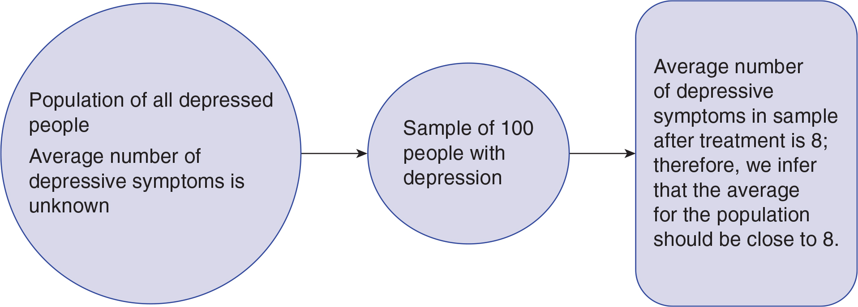
Figure 1.1: A Pictorial Representation of Using a Sample to Estimate a Population Parameter
Notes:
Learning Objective: Use common statistical terms correctly in a statistical context
p. 7

Slide 19
Independent and Dependent Variables
Independent variable (IV)
a variable with two or more levels that are expected to have different impacts on another variable.
Dependent variable (DV)
is the outcome variable that is used to compare the effects of the different IV levels.
Notes:
Learning Objective: Use common statistical terms correctly in a statistical context

Slide 20
Scales of Measurement
There are four different scales of measurement that vary in their degree of measurement precision
Nominal
Ordinal
Interval
Ratio
Notes:
Learning Objective: Identify the scale of measurement of a variable (nominal, ordinal, or interval/ratio)

Slide 21
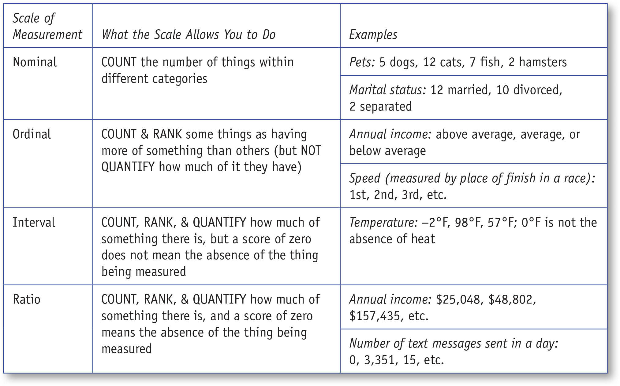
Table 1.1: The Four Scales of Measurement, What They Allow, and Examples
Notes:
Learning Objective: Identify the scale of measurement of a variable (nominal, ordinal, or interval/ratio)
p. 11

Slide 22
Discrete Versus Continuous Variables
Discrete variable
only occurs in whole units
Continuous variable
occurs in fractions of units
Notes:
Learning Objective: Determine if a variable is discrete or continuous. Determine if a variable is discrete or continuous

Slide 23
Graphing Data
Discrete Data
Continuous Data
Bar graphs
bars do not touch
Histograms
bars touch
Line graphs
Notes:
Learning Objective: Create and interpret frequency distribution tables, bar graphs, histograms, and line graphs
Learning Objective: Explain when to use a bar graph, histogram, and line graph

Slide 24
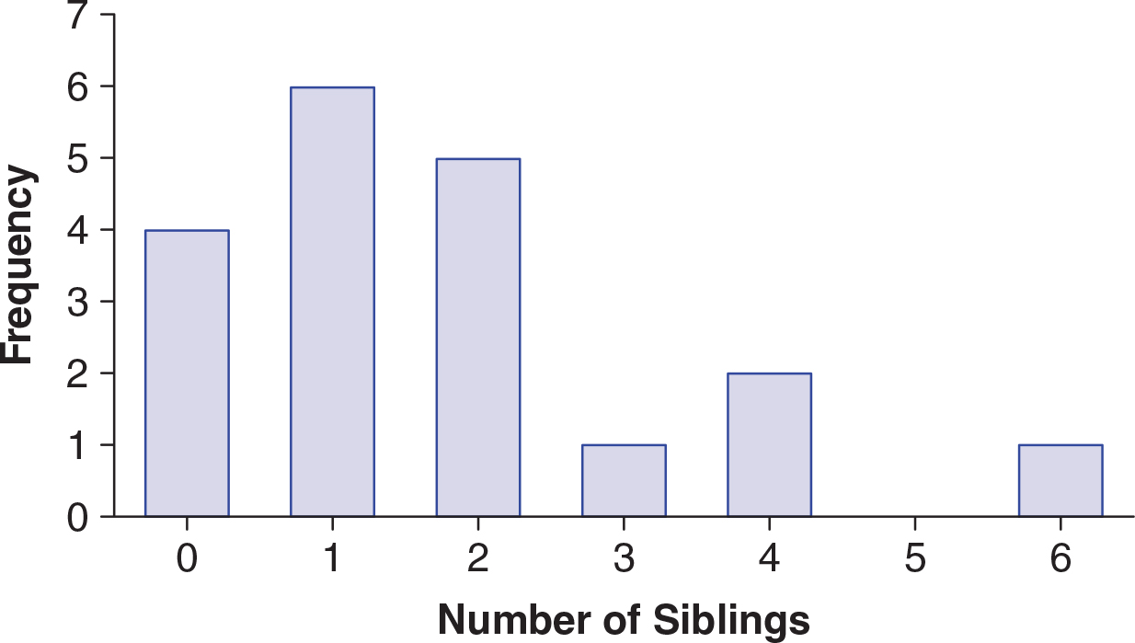
Figure 1.2: Bar Graph of Variable, Number of Siblings, Collected From a Sample of 19 Students
Notes:
Learning Objective: Create and interpret frequency distribution tables, bar graphs, histograms, and line graphs
Learning Objective: Explain when to use a bar graph, histogram, and line graph
Figure from p.14
Example of a bar graph for discrete data
Raw data: 0, 0, 0, 0, 1, 1, 1, 1, 1, 1, 2, 2, 2, 2, 2, 3, 4, 4, 6 (p. 13).
DV = Number of siblings Sample size = 19.

Slide 25
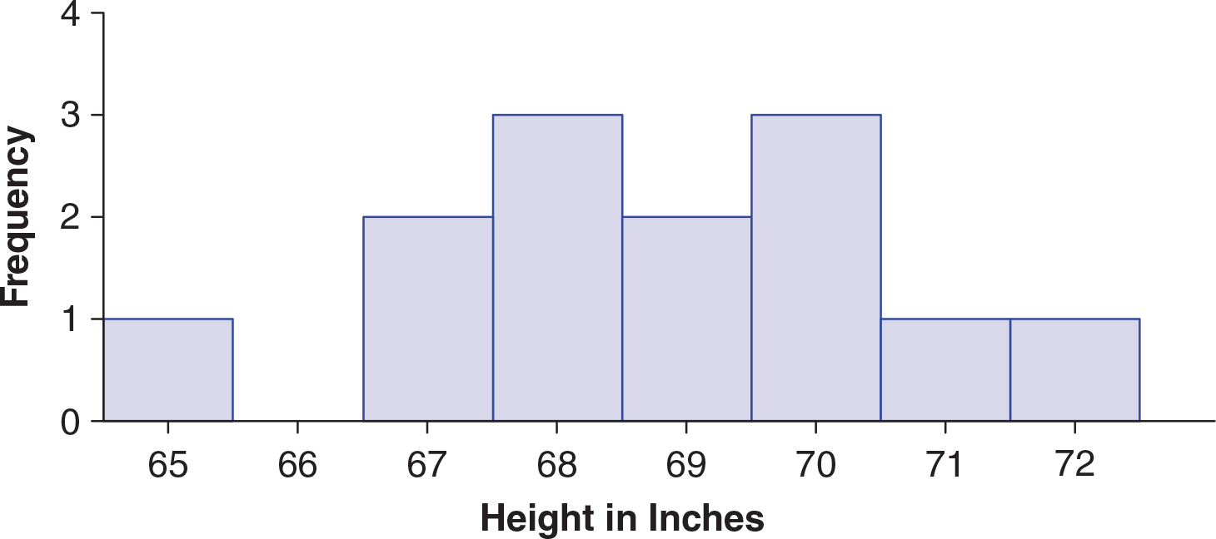
Figure 1.3: Frequency Histogram of Variable, Height in Inches, Collected From a Sample of 13 Volleyball Players
Notes:
Learning Objective: Create and interpret frequency distribution tables, bar graphs, histograms, and line graphs Learning Objective: Explain when to use a bar graph, histogram, and line graph
Figure from p.14
Example of a histogram for continuous data
Raw data: 65, 67, 67, 68, 68, 68, 69, 69, 70, 70, 70, 71, 72 (p. 14).
DV = height of players on a volleyball team rounded to the nearest inch: Sample size = 13.

Slide 26
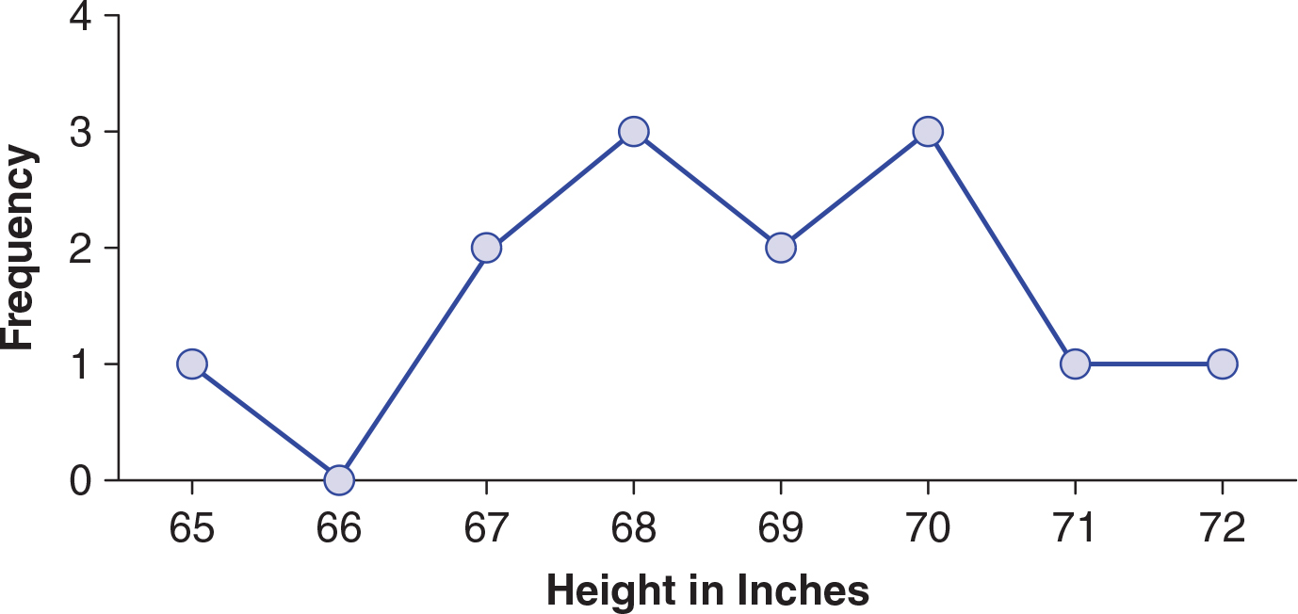
Figure 1.4: Frequency Line Graph of Variable, Height in Inches, Collected From a Sample of 13 Volleyball Players
Notes:
Learning Objective: Create and interpret frequency distribution tables, bar graphs, histograms, and line graphs Learning Objective: Explain when to use a bar graph, histogram, and line graph
Figure from p.15
Example of a line graph for continuous data
Raw data: 65, 67, 67, 68, 68, 68, 69, 69, 70, 70, 70, 71, 72 (p. 14).
DV = height of players on a volleyball team rounded to the nearest inch: Sample size = 13.
NOTE this is the same data that is represented in the Histogram in Figure 1.3

Slide 27
Shapes of Distributions
Distribution
a group of scores
Bell-shaped distributions
also called normal distributions or Gaussian distributions
most of the scores pile up in the middle
as you move further from the middle, the frequency of the scores gets less
symmetrical in that the right and left sides of the graph are identical.
Notes:
Learning Objective: Use common statistical terms correctly in a statistical context Learning Objective: Create and interpret frequency distribution tables, bar graphs, histograms, and line graphs

Slide 28
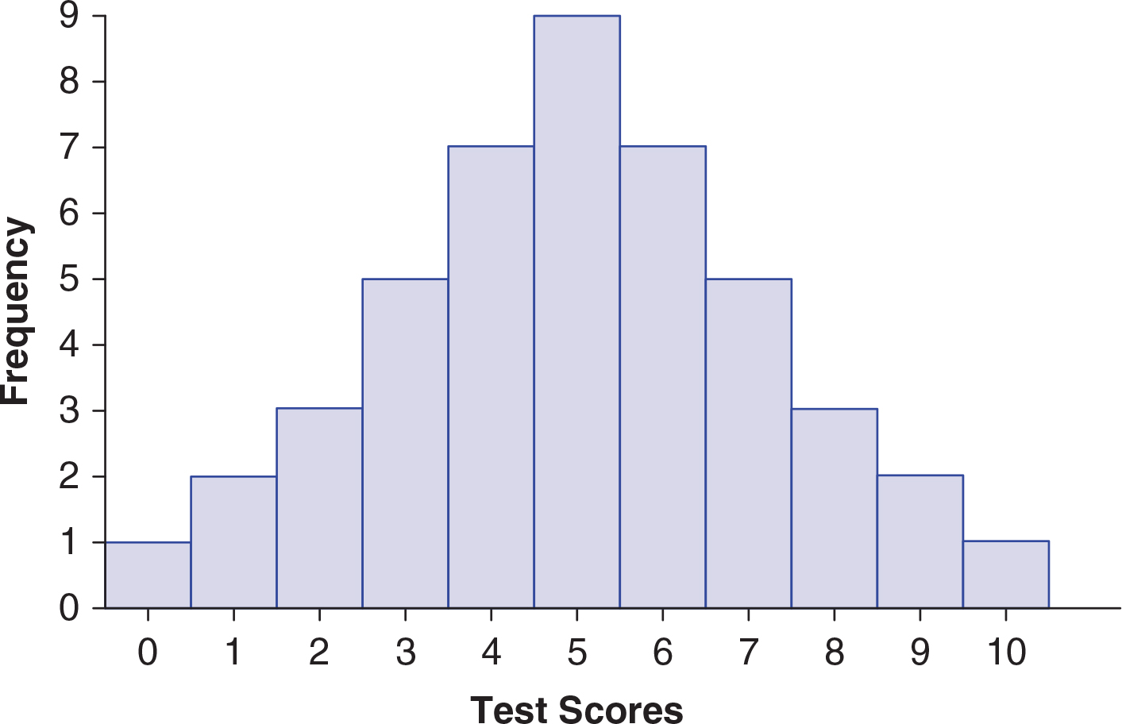
Figure 1.5: Frequency Histogram of Test Scores That Form a Normal Curve
Notes:
Learning Objective: Create and interpret frequency distribution tables, bar graphs, histograms, and line graphs
Figure from p.16
Example of a normal curve, Figure 1.5
Bell shaped Symmetric, left to right
Most scores in the center
Few scores in either tail

Slide 29
Shapes of Distributions
Skewed distributions
are asymmetrical, the right and left sides are not identical
Positively skewed distributions
“tail” points to the right
Negatively skewed distributions
“tail” points to the left
Notes:
Learning Objective: Use common statistical terms correctly in a statistical context Learning Objective: Create and interpret frequency distribution tables, bar graphs, histograms, and line graphs
“There are statistics that you can compute to quantify exactly how skewed a distribution is (see Field, 2013, for an excellent discussion), but we will just eyeball the graphs to determine if they deviate from normal” p. 16.

Slide 30
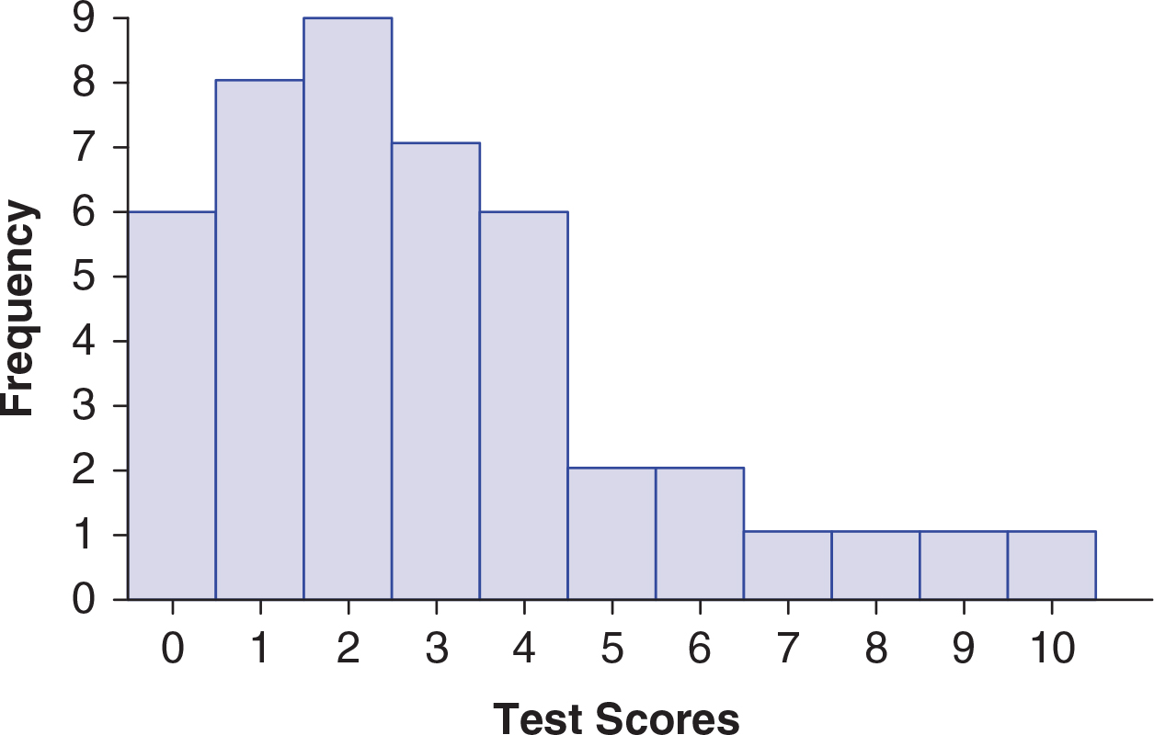
Figure 1.6: Positively Skewed Distribution
Notes:
Learning Objective: Create and interpret frequency distribution tables, bar graphs, histograms, and line graphs
Figure from p.17
Example of a positively skewed distribution, Figure 1.6
“tail” points to the right

Slide 31
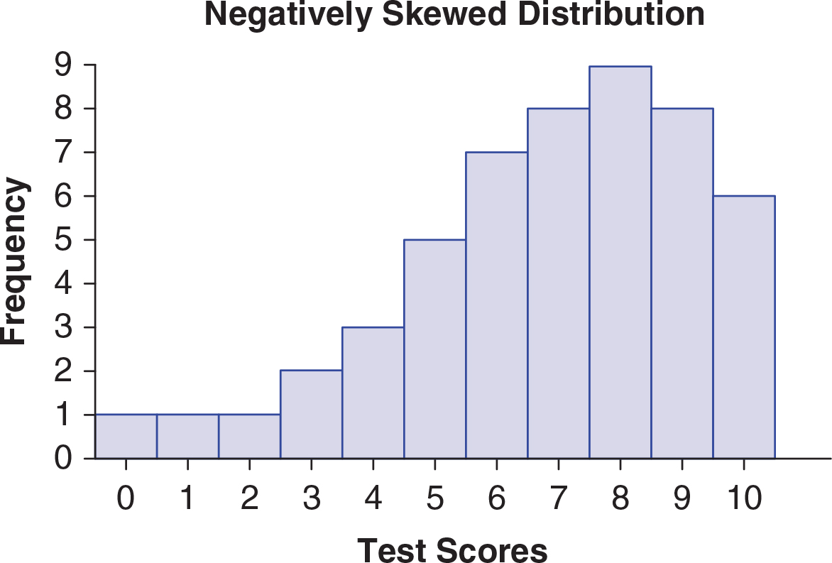
Figure 1.7: Negatively Skewed Distribution of Scores
Notes:
Learning Objective: Create and interpret frequency distribution tables, bar graphs, histograms, and line graphs
Figure from p.17
Example of a negatively skewed distribution, Figure 1.7
“tail” points to the left

Slide 32
Shapes of Distributions
Kurtosis
the extent to which distributions have an exaggerated peak versus a flatter appearance
Leptokurtic distributions
have a higher, more exaggerated peak than a normal curve
Platykurtic distributions
have a flatter peak
Notes:
Learning Objective: Use common statistical terms correctly in a statistical context Learning Objective: Create and interpret frequency distribution tables, bar graphs, histograms, and line graphs

Slide 33
Frequency Distribution Tables
A frequency distribution table organizes the data, so it is easier to interpret
The first column (x) shows the possible response categories
The next column (f) shows where to record the frequency of each response
Notes:
Learning Objective: Use common statistical terms correctly in a statistical context Learning Objective: Create and interpret frequency distribution tables, bar graphs, histograms, and line graphs

Slide 34
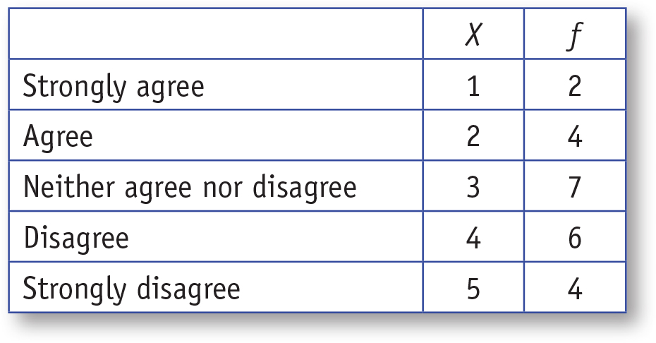
Table 1.2: Frequency Distribution Table of the Variable “I Am Very Happy With My Cell PhoneService Provider”
Notes:
Learning Objective: Create and interpret frequency distribution tables, bar graphs, histograms, and line graphs
Figure from p.19
Example of a frequency distribution table

Slide 35
SPSS
Enter data into SPSS and generate frequency distribution tables and graphs
Notes:
Learning Objective: Enter data into SPSS and generate frequency distribution tables and graphs

Slide 36
SPSS
SPSS is a statistical package used to conduct many statistical analyses.
The instructions and screenshots in the text are for Version 22
Notes:
Learning Objective: Use common statistical terms correctly in a statistical context Learning Objective: Create and interpret frequency distribution tables, bar graphs, histograms, and line graphs

Slide 37
SPSS Data File
Data View
Enter your data here
Variable View
Name your variable here
Notes:
Learning Objective: Enter data into SPSS and generate frequency distribution tables and graphs
The text refers to the data from Table 1.2 about cell phones.

Slide 38
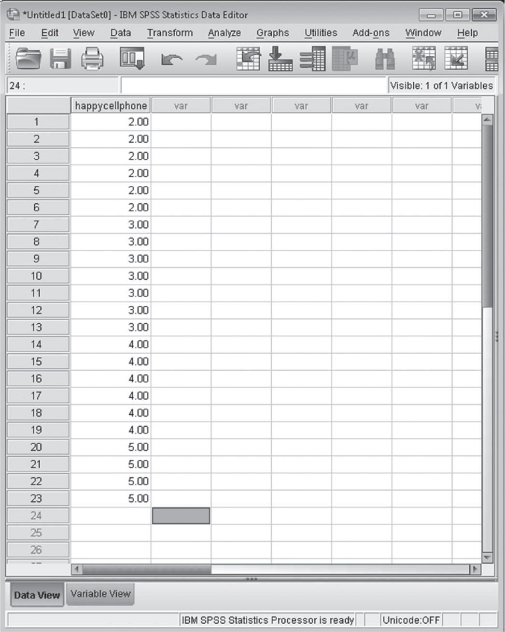
Figre 1.10: Screenshot of SPSS Data Entry Screen
Notes:
Learning Objective: Create and interpret frequency distribution tables, bar graphs, histograms, and line graphs
Figure from p.20
Example of an SPSS data file
It shows the tabs for Data View and Variable view at the bottom left.

Slide 39
Creating Frequency Distribution Tables and Graphs
From the Data View screen, click on Analyze, Descriptive Statistics, and then Frequencies.
To create a graph, click on the Charts button and then choose the type of graph you want to create (Bar chart, Pie chart, or Histogram). Click on the Continue button.
Notes:
Learning Objective: Enter data into SPSS and generate frequency distribution tables and graphs
The text refers to the data from Table 1.2 about cell phones that have been entered into an SPSS data file.

Slide 40
Creating Frequency Distribution Tables and Graphs
Be sure that the Display Frequency Tables box is checked if you want to create a frequency distribution table.
Click on the OK button to create the frequency distribution table and graph.
Notes:
Learning Objective: Enter data into SPSS and generate frequency distribution tables and graphs
The text refers to the data from Table 1.2 about cell phones that have been entered into an SPSS data file.

Slide 41
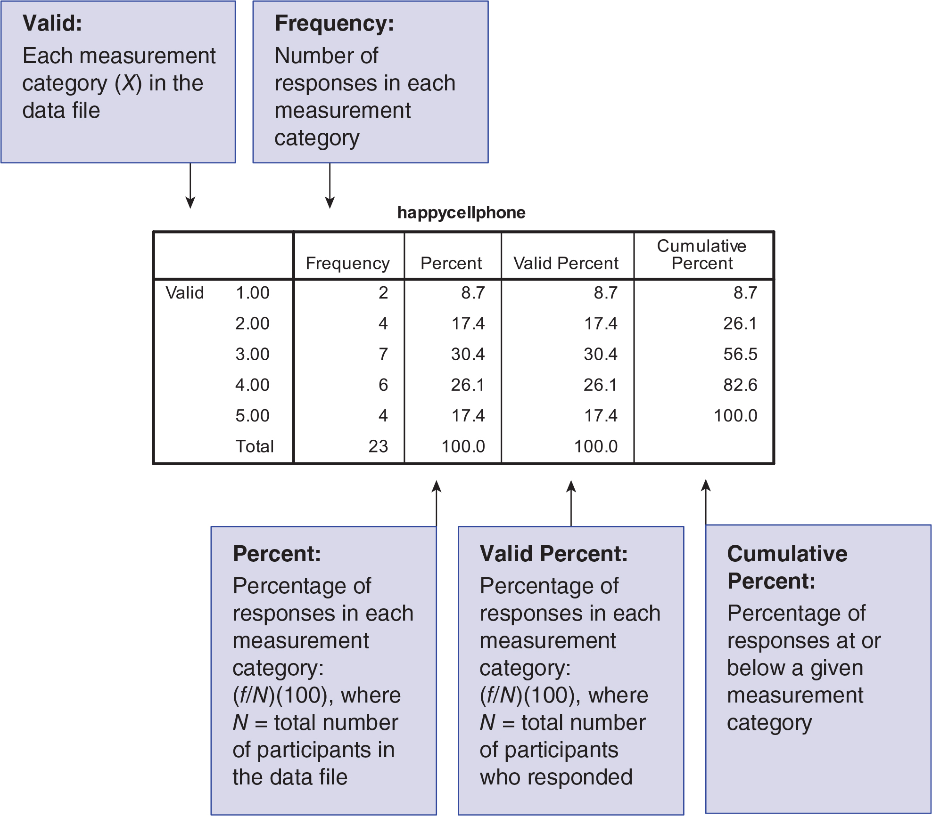
Figre 1.11: Annotated SPSS Frequency Table Output
Notes:
Learning Objective: Create and interpret frequency distribution tables, bar graphs, histograms, and line graphs
Figure from p.22
Example of an SPSS Frequency Table Output.

Slide 42
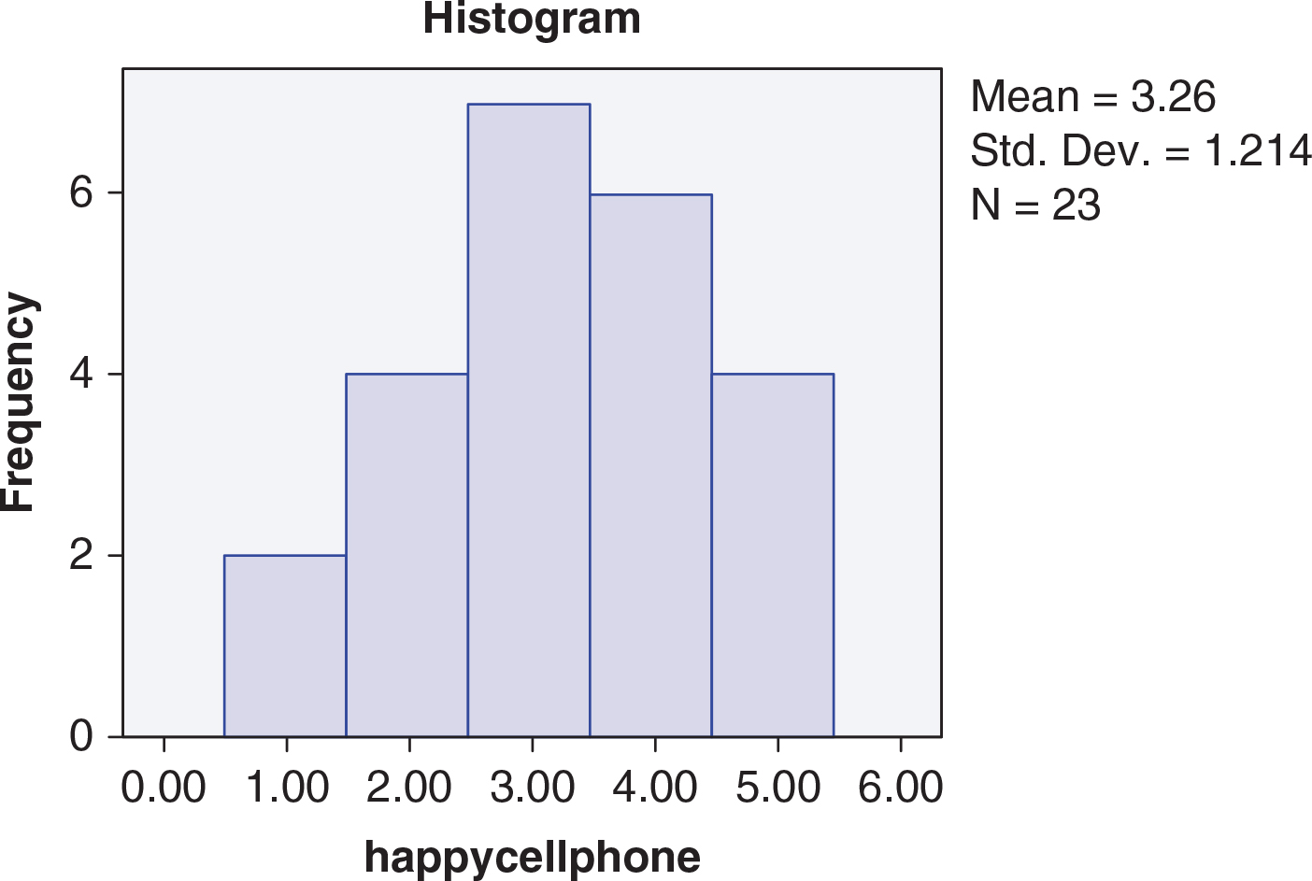
Figre 1.12: Frequency Histogram of “I Am Very Happy With My Cell Phone Service Provider” Data
Notes:
Learning Objective: Create and interpret frequency distribution tables, bar graphs, histograms, and line graphs
Figure from p.23
Example of an SPSS Frequency Histogram

Slide 43
Overview of the Activity
Enter data into SPSS and generate frequency distribution tables and graphs
Notes:
Learning Objectives
After reading the chapter and completing this activity, you should be able to do the following:
• Use common statistical terms correctly in a statistical context
•Construct a frequency distribution table from a bar graph
•Interpret data from a frequency distribution
•Use SPSS to create a frequency table
•Sketch a frequency distribution
•Identify distributions that are bell shaped, positively skewed, negatively skewed, leptokurtic, and
platykurtic
•Identify nominal, ordinal, and interval/ratio variables in research scenarios
•Identify discrete and continuous variables in research scenarios

Slide 44
Therapeutic Touch
Therapeutic touch (TT) involves no actual physical contact.
practitioners use their hands to move “human energy fields” (HEFs) in an attempt to promote healing.
Proponents claim that it can help with relaxation, reduce pain, and improve the immune system.
Notes:
Learning Objective: Enter data into SPSS and generate frequency distribution tables and graphs

Slide 45
Therapeutic Touch
Emily Rosa (who was 9-years-old at the time) and her colleagues (including her parents) investigated the basis of these TT claims by putting a sample of actual TT practitioners to the test (Rosa, Rosa, Sarner, & Barrett, 1998).
Notes:
Learning Objective: Enter data into SPSS and generate frequency distribution tables and graphs

Slide 46
Therapeutic Touch
Individual practitioners sat at a table facing a large divider that prevented them from seeing their own hands or Emily.
The practitioners placed both of their hands through the divider on the table, palms up.
Notes:
Learning Objective: Enter data into SPSS and generate frequency distribution tables and graphs

Slide 47
Therapeutic Touch
Emily began each trial by flipping a coin to determine where to place her hand.
She then placed her hand 8–10 cm above one of the practitioner’s hands.
The practitioners had to “sense” the HEF to determine whether Emily’s hand was over their right or left hand.
Each practitioner went through a total of 10 of these trials.
Notes:
Learning Objective: Enter data into SPSS and generate frequency distribution tables and graphs

Slide 48
Therapeutic Touch
If the TT practitioners can actually sense HEFs, they should be able to choose the correct hand far better than chance (i.e., 5 of 10 times).
However, if they really can’t detect HEFs and the practitioners were really guessing, you would expect them to choose the correct hand an average of 5 of 10 times.
Notes:
Learning Objective: Enter data into SPSS and generate frequency distribution tables and graphs

Slide 49
General Social Survey
National Opinion Research Center asks a random sample of adults in the United States to complete the General Social Survey (GSS) every 2 years.
You will be using a small portion of the GSS data set, saved in a file titled “gss2010.sav.”
Download the gss2010.sav file from:
http://www.sagepub.com/carlson/study/resources.htm
Notes:
Learning Objective: Enter data into SPSS and generate frequency distribution tables and graphs
The data file, gss2010.sav can be found on the text book website at:
http://www.sagepub.com/carlson/study/resources.htm

Slide 50
General Social Survey
Use SPSS to create a frequency distribution table and graph of “Scientific Knowledge” scores
From the Data View screen, click on Analyze, Descriptive Statistics, and then Frequencies.
Move the variable(s) of interest into the Variable(s) box. In this case, you will move “Scientific Knowledge” into the Variable(s) box.
Notes:
Learning Objective: Enter data into SPSS and generate frequency distribution tables and graphs
The data file, gss2010.sav can be found on the text book website at:
http://www.sagepub.com/carlson/study/resources.htm

Slide 51
General Social Survey
Make sure the Display Frequency Tables box is checked.
To create a graph, click on the Charts button and then choose Bar chart. Click on the Continue button.
Click on the OK button to create the frequency distribution table and graph.
Notes:
Learning Objective: Enter data into SPSS and generate frequency distribution tables and graphs
The data file, gss2010.sav can be found on the text book website at:
http://www.sagepub.com/carlson/study/resources.htm

